Slide 1
PYTHON TUTORIALS
INTRODUCTION
SHALINI SHEETAL
CSE, THIRD YR

Slide 2
What is Python ?
A programming language!
Python is a general purpose programming language that is often applied in scripting roles.
It was created by Guido van Rossum, and released in 1991.
So, Python is programming language as well as scripting language.
Python is also called as Interpreted language.
It is used for:
web development (server-side),
software development,
mathematics,
system scripting.

Slide 3
Program vs Scripting language
a program is executed
(i.e. the source is first compiled, and
the result of that compilation is expected)
A "program" in general, is a
sequence of instructions
written so that a computer
can perform certain task
a script is interpreted
(i.e. the script is executed line by line)
A "script" is code written in a scripting language.
A scripting language is nothing but a type of programming language in which we can write code to control another software application.

Slide 4
Why use Python?
A whole lot of reasons!
The following primary factors cited by Python users seem to be these:
Python is object-oriented
Structure supports such concepts as polymorphism, operation overloading, and multiple inheritance.
Indentation
Indentation is one of the greatest future in Python.
It's free (open source)
Downloading and installing Python is free and easy. Source code is easily accessible

Slide 5
Why use Python?
… continued
It's powerful
- Dynamic typing
- Built-in types and tools
- Library utilities
- Third party utilities (e.g. Numeric, NumPy, SciPy)
- Automatic memory management
It's portable
- Python runs virtually every major platform used today
- As long as you have a compatible Python interpreter installed, Python programs will run in exactly the same manner, irrespective of platform

Slide 6
Why use Python?
It's mixable
Python can be linked to components written in other languages easily
- Linking to fast, compiled code is useful to computationally intensive problems
Python/C integration is quite common
It's easy to use
- No intermediate compile and link steps as in C/ C++
- Python programs are compiled automatically to an intermediate form called bytecode, which the interpreter then reads
- This gives Python the development speed of an interpreter without the performance loss inherent in purely interpreted languages.
It's easy to learn
- Structure and syntax are pretty intuitive and easy to grasp.

Slide 7
What can I do with Python…?
System programming
GUI programming
Internet scripting
Component
integration
Database programming
Gaming, images, robotics and more….

Slide 8
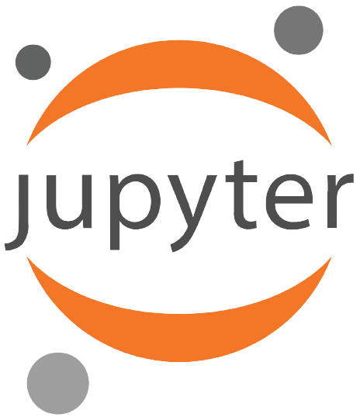
I shall be using jupyter notebook for executing python codes.
Follow the below link for more details:
How to install Jupyter-Notebook
Alternatives: PyCharm, VS Code etc.

